Slide 1

A gamified introduction to Python Programming Lecture 8 The list type and its uses
Matthieu DE MARI – Singapore University of Technology and Design

Slide 2

Outline (Chapter 8)
What is the list type, in detail, this time?
What are the indexing, slicing, updating and traversing a list operations?
What are lists of lists and their uses?
How to create, add and remove elements from a list?
What are advanced operations on list such as concatenation, repetition, insertion, etc?
What does RTFM mean?
Practice on lists.

Slide 3
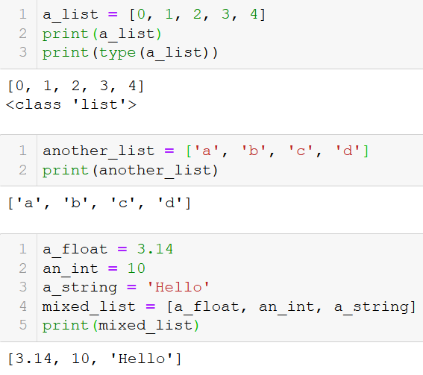
The list type
Definition (lists): a list is a sequence of several variables or elements, listed, in order, between brackets and separated by commas.
Lists can contain variables of any types (int, float, string, etc.) and lists can also contain mixed types of variables.
A list with no elements, is called an empty list and is noted [].

Slide 4
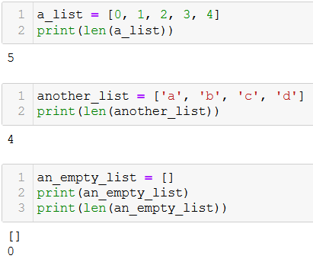
Length of a list
Definition (length of a list): The length of a list consists of the number of elements in the list.
It can be simply computed by using the len() function on a list, which returns a positive integer corresponding to the number of elements in the list.
An empty list, defined as [], has zero elements in it.

Slide 5
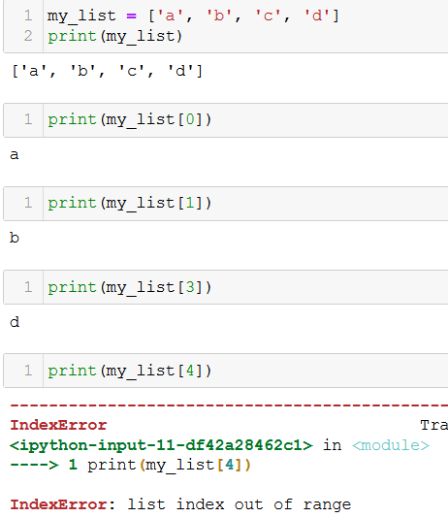
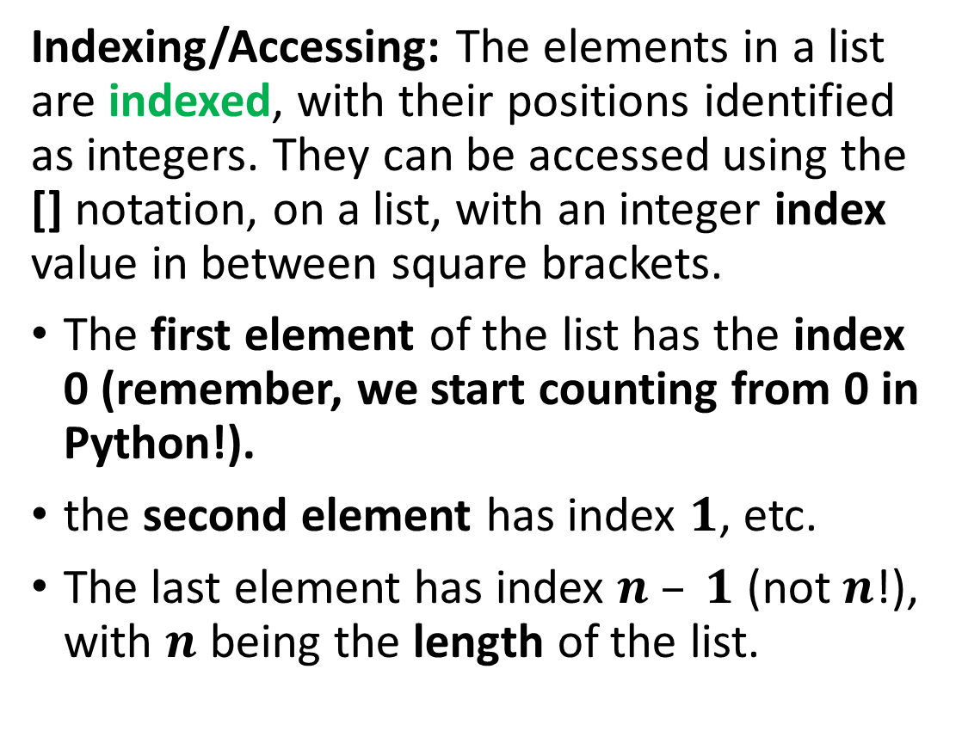
Indexing/Accessing the elements of a list
Indexing/Accessing: The elements in a list are indexed, with their positions identified as integers. They can be accessed using the [] notation, on a list, with an integer index value in between square brackets.
The first element of the list has the index 0 (remember, we start counting from 0 in Python!).
the second element has index $1$, etc.
The last element has index $n – 1$ (not $n$!), with $n$ being the length of the list.

Slide 6
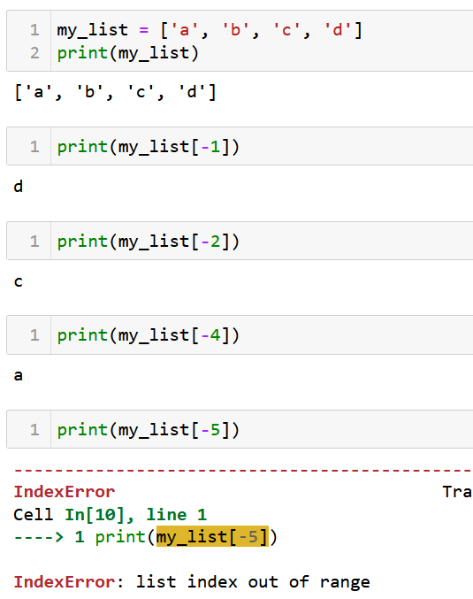
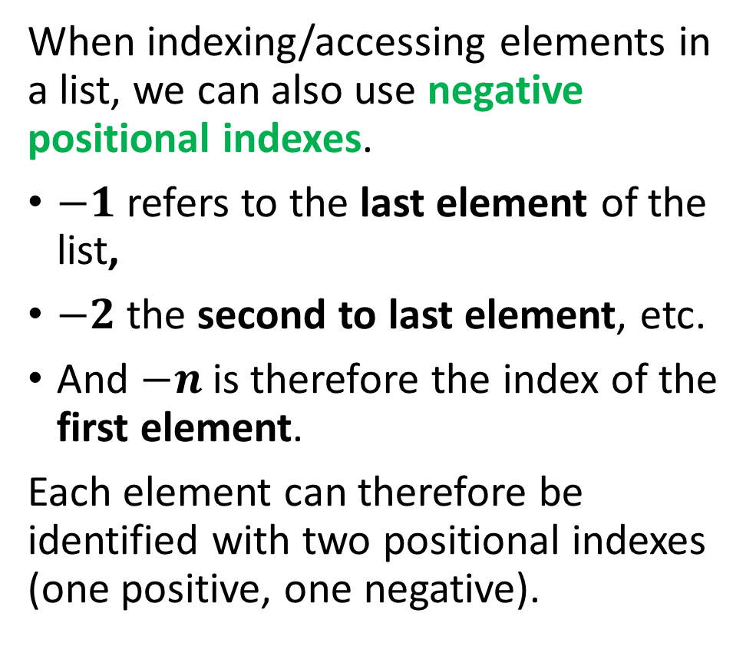
Indexing/Accessing the elements of a list
When indexing/accessing elements in a list, we can also use negative positional indexes.
$−1$refers to the last element of the list,
$−2$the second to last element, etc.
And $−n$is therefore the index of the first element.
Each element can therefore be identified with two positional indexes (one positive, one negative).

Slide 7
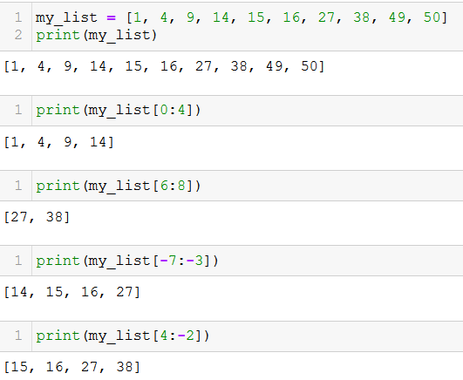
Slicing a list
Definition (slicing): Slicing is used to retrieve a subset of the list, by specifying to indexes, separated with a colon (:) symbol. Slicing with [a:b] returns another list, containing all elements of the original list:
Starting from positional index a (with a included),
All the way to positional index b (with b not included).
Note: Intuitively, it seems to have a roughly similar behavior to the range() function!

Slide 8
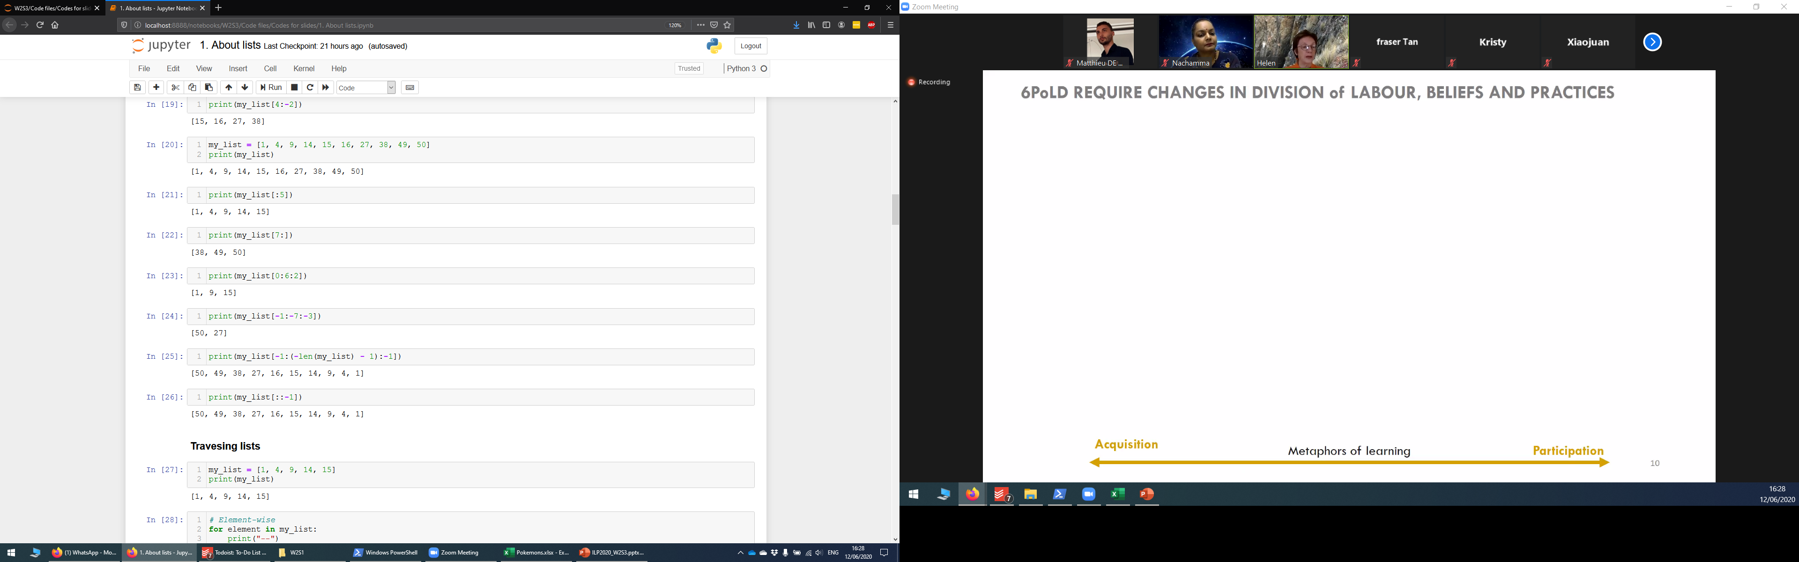
Slicing a list
Additional rule: Omitting a value in a slicing, either a or b, has effects.
[:b] means:
all elements from the beginning of the list,
until index b (with b not included).
[a:] means:
all element from index a,
until the end of the list (last element included).

Slide 9
Slicing a list
Additional rule #2: Slicing with three values [a:b:c] returns another list as a result, containing all elements of the original list:
Starting from index a (with element in position a included),
All the way to index b (with element in position b not included),
With steps of size c.
Note: Behavior similar to range().

Slide 10



Please download and install the Slido app on all computers you use
Which one of the statements below allows to display all the elements of a list my_list, in reverse order?
ⓘ Start presenting to display the poll results on this slide.

Slide 11
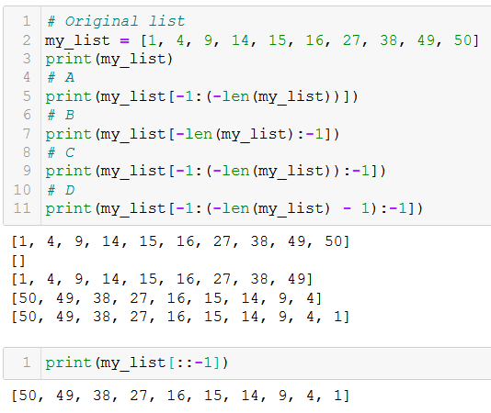
Slicing a list

Slide 12
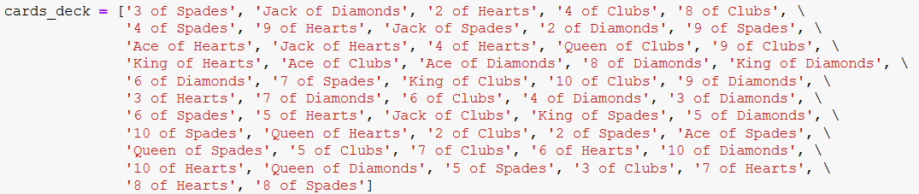
Activity 1 - Distributing a deck of cards
Let us consider a standard, shuffled deck of cards, defined as a list.
In this activity, we will distribute the cards between several players.

Slide 13
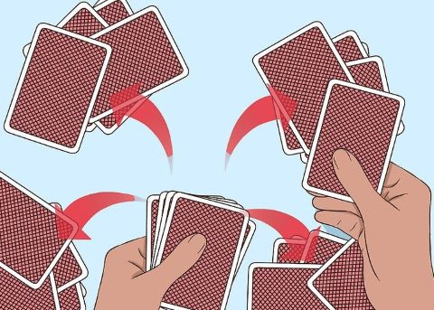
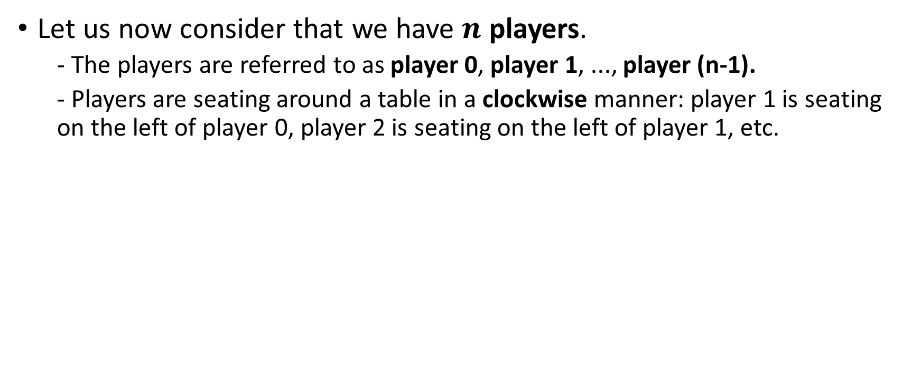
Activity 1 - Distributing a deck of cards
Let us now consider that we have $n$ players.
- The players are referred to as player 0, player 1, ..., player (n-1).
- Players are seating around a table in a clockwise manner: player 1 is seating on the left of player 0, player 2 is seating on the left of player 1, etc.
1
2
0
3

Slide 14
Activity 1 - Distributing a deck of cards
Write a function distribute_cards(), which
- receives a shuffled deck of cards, cards_deck, as its first input parameter,
- receives a number of players seating at the table, players_number, as its second input parameter,
- receives an integer player_index, with value in [0, players_number - 1], as its third input parameter. This corresponds to a specific player sitting at the table.
- receives an integer start_from, with value in [0, players_number - 1], as its fourth input parameter. This value corresponds to the first player to receive a card.

Slide 15
Activity 1 - Distributing a deck of cards
The function distribute_cards() then
- distributes all cards in the deck, one card at a time, in clockwise order, between all players,
- starting from the player with index start_from.
- It is ok if some players have one more card than other players (for instance, if the number of cards is not divisible by number of players)
The function distribute_cards() returns a list of cards, player_hand, corresponding to the hand of player with index player_index, after we are done distributing the cards. Find a smart slicing for the deck!

Slide 16
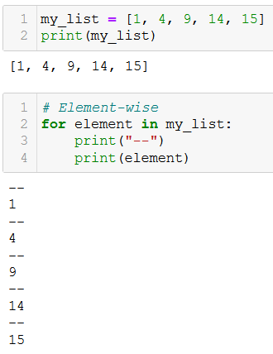
Traversing lists (element-wise)
You have seen how we can give lists to for statements to traverse and retrieve each element one-by-one.
The “for element in list:” approach is commonly referred to as traversing a list element-wise.

Slide 17
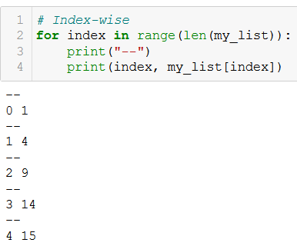
Traversing lists (index-wise)
You have seen how we can give lists to for statements to traverse and retrieve each element one-by-one.
The “for index in range(len(list)):” approach is commonly referred to as traversing a list index-wise.

Slide 18
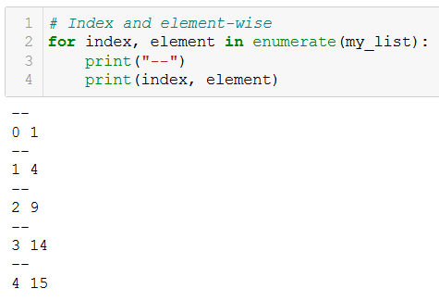
Traversing lists (index and element-wise)
You have seen how we can give lists to for statements to traverse and retrieve each element one-by-one.
You have also seen how to use the enumerate() generator, and how it allows to retrieve both the indexes and elements at the same time, while traversing a list.

Slide 19
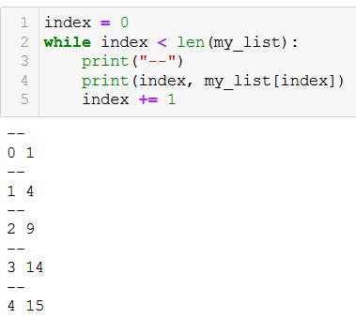
Traversing lists (while)
You have seen how we can give lists to for statements to traverse and retrieve each element one-by-one.
You can also replace the for loop with a while loop. (Not recommended however!)

Slide 20

Updating an element in a list
Definition (Updating a list): The indexing notation list[index] = value can be used to update an element in the list.
The accessed element in given position index (with the = sign symbol) receives a new value. This replaces the current value in the list with a new value.
Note: An element can be updated with a completely different type. Also works with slicings.

Slide 21
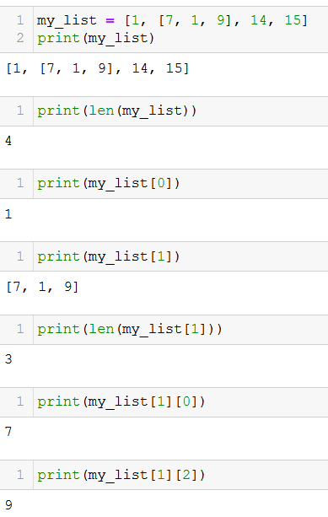
Lists of lists
Observation: Elements of a list can be any type, therefore an element of a list can be another list! This is called a list of lists.
Careful with the len() function! If an element of a list is a list itself, it still only counts as 1 element for the main list!
You can use multiple indexing, i.e. using [] several times in a row, to access the elements of a sublist.
Very useful to represent tables (as in Excel) or matrices (something for later).

Slide 22
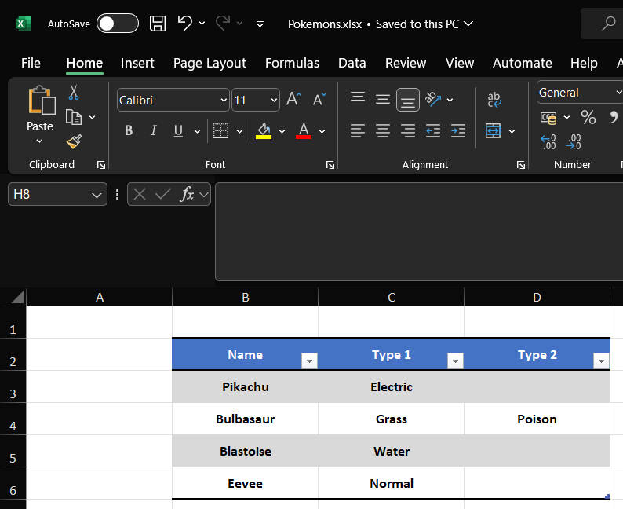
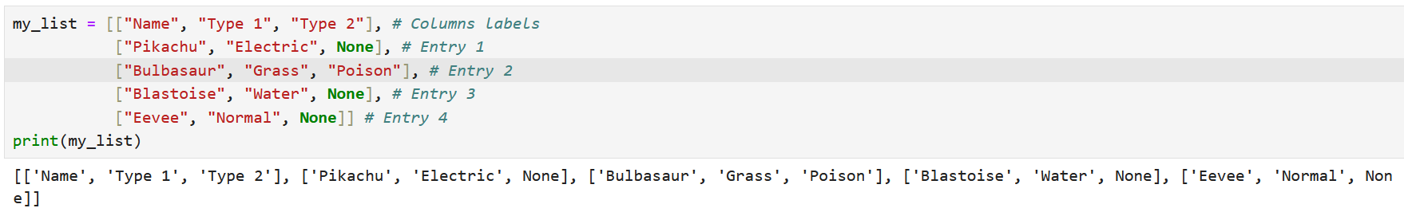
Lists of lists
Lists of lists are commonly used in Python to represent tables of values.
Widely used in Data Science because Python allows for more processing operations than Excel!

Slide 23
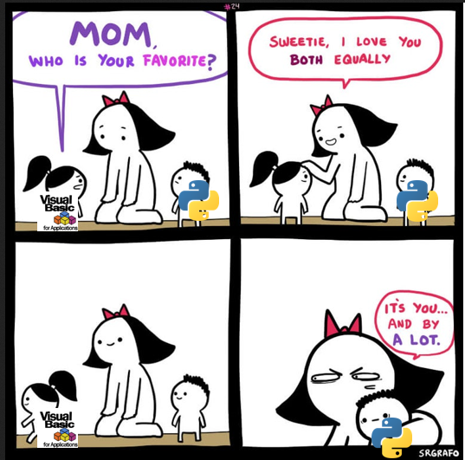


Lists of lists
Lists of lists are commonly used in Python to represent tables of values.
Widely used in Data Science because Python allows for more processing operations than Excel!
Great news: this means that you will no longer need Excel!

Slide 24
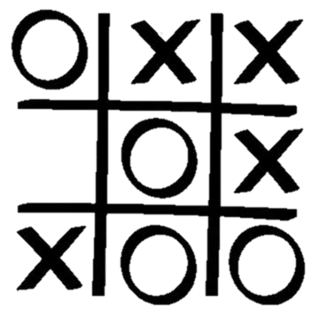
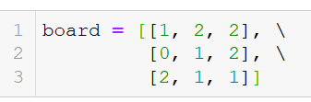
Activity 2 - TicTacToe
A tic tac toe board can be represented as a list of lists, by
defining a list of three elements,
each element is a sublist of three elements corresponding to each line, from up to down,
each sublist contains three elements, corresponding to each position on the line, from left to right,
element will have a value 0 if the position is empty,
element will have a value 1 if the position contains a circle,
element will have a value 2 if the position contains a cross,

Slide 25
Activity 2 - TicTacToe
A tic tac toe board can be represented as a list of lists.
Write a function board_winner(), which:
receives a board, defined as a list of lists, as its sole input parameter,
returns a single output, which consists of the value
1 if the circles won,
2 if the crosses won,
and 0 if there is no clear winner.

Slide 26
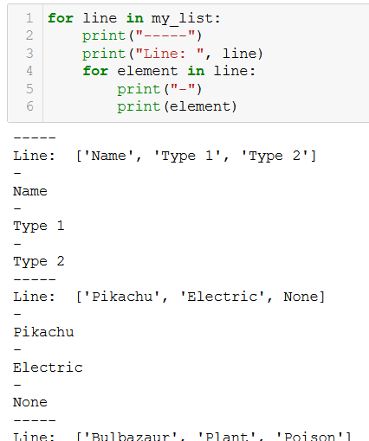
Lists of lists
Traversing lists of lists requires the use of nested for loops.
The first for loop browses through the lines, which are the sublists of the main list, one line at a time.

Slide 27
Lists of lists
Traversing lists of lists requires the use of nested for loops.
The first for loop browses through the lines, which are the sublists of the main list, one line at a time.
The second for loop browses through the elements in the sublists, one element at a time.

Slide 28
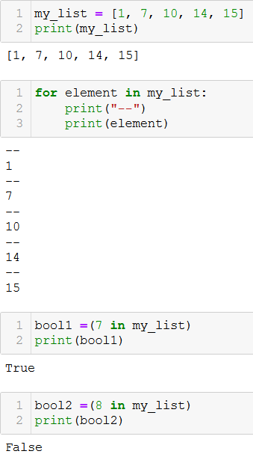
Membership: the in keyword
We have seen: the in keyword can be used to traverse lists in for loops (it connects iteration variables and lists/generators).
New!: The in keyword can also be used as a Boolean question for membership (is element in list?).
If the element appears in the list, then the result of the operation is a Boolean True.
And False otherwise.

Slide 29
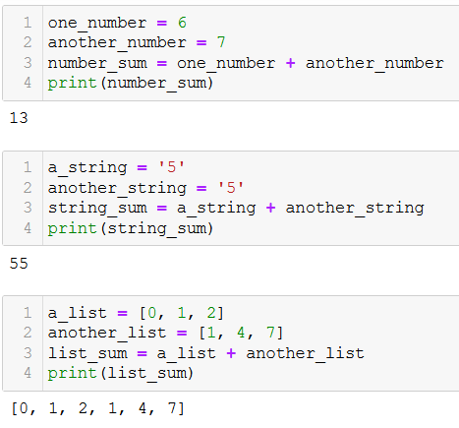
Concatenation: + operator overload for lists
Concatenation: you can merge two lists together, by using the + operator.
When summing two lists with +, Python does not sum the elements, as with numbers or vectors in mathematics.
Instead, it behaves as with strings and concatenates both.

Slide 30
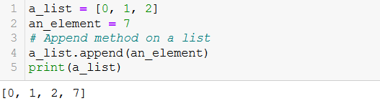
Adding an element with the append() method
Adding/Appending an element: you can add an element at the end of an existing list with the append() method.
The append() method modifies the list on which the method is applied.
No need to reassign (That would be a mistake!). This would be incorrect
a_list = a_list.append(an_element)

Slide 31
Please download and install the Slido app on all computers you use
What happens to my_list after the operation my_list = my_list.append(7)?
ⓘ Start presenting to display the poll results on this slide.

Slide 32
Activity 3 - Party merger
In many video games, you might form a group of friends and play together. In this activity, we will define a function, which attempts to merge two groups into a single one.
A group will simply consist of a list of names, as shown below.
group = ["Matt", "Oka", "Tony", "Norman"]
Write a function merge_groups(), which receives two groups of people as lists of names.
We will call these two groups variables, group1 and group2 respectively.
This function will merge both groups into a new one containing the members of both groups, and will return the merged_group list as its only output.
However, it will only do so, if the resulting merged group does not contain more than 6 people. Otherwise, the function will return both group1 and group2, therefore refusing to merge them.

Slide 33
Activity 4 – Complete, sorted deck of cards
A standard deck of cards consists of 52 different cards, forming all 52 possible combinations of 4 possible suits and 13 possible values (4x13 = 52!)
The 4 possible suits are listed in the suits_list below.
suits_list = ["Hearts", "Diamonds", "Spades", "Clubs"]
The 13 possible values are listed in the values_list below.
values_list = ["Ace", "2", "3", "4", "5", "6", "7", "8", "9", "10", "Jack", "Queen", "King"]

Slide 34
Activity 4 – Complete, sorted deck of cards
Write a function complete_deck(),
which receives suits_list and values_list, as input parameters,
suits_list = ["Hearts", "Diamonds", "Spades", "Clubs"]
values_list = ["Ace", "2", "3", "4", "5", "6", "7", "8", "9", "10", "Jack", "Queen", "King"]
And returns a complete sorted deck, as defined on the right.
deck = ['Ace of Hearts', '2 of Hearts', '3 of Hearts', '4 of Hearts’, …, 'Queen of Hearts', 'King of Hearts', 'Ace of Diamonds', '2 of Diamonds', '3 of Diamonds', '4 of Diamonds’, …, 'Queen of Diamonds', 'King of Diamonds', 'Ace of Spades', '2 of Spades', '3 of Spades', '4 of Spades’, …, 'Queen of Spades', 'King of Spades', 'Ace of Clubs', '2 of Clubs', '3 of Clubs', '4 of Clubs’, … 'Queen of Clubs', 'King of Clubs']

Slide 35
More methods and functions on lists
The lists objects in Python have many more built-in methods and functions you could use.
We do not expect you to know about all these methods and functions, nor about how they work in detail.
Just know where to find the information if you need it.
Also, do not be afraid to read the Python documentation!
List documentation: https://docs.python.org/3/tutorial/datastructures.html

Slide 36
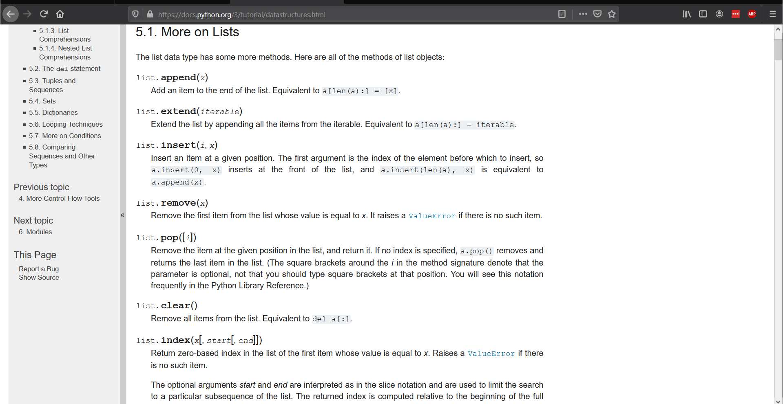
More methods and functions on lists

Slide 37
RTFM
Definition (RTFM): The acronym RTFM stands for

Slide 38
RTFM
Definition (RTFM): The acronym RTFM stands for “Read.

Slide 39
RTFM
Definition (RTFM): The acronym RTFM stands for “Read. The.

Slide 40
RTFM
Definition (RTFM): The acronym RTFM stands for “Read. The. F***ing.

Slide 41
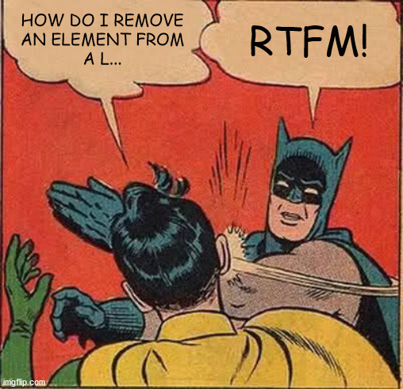
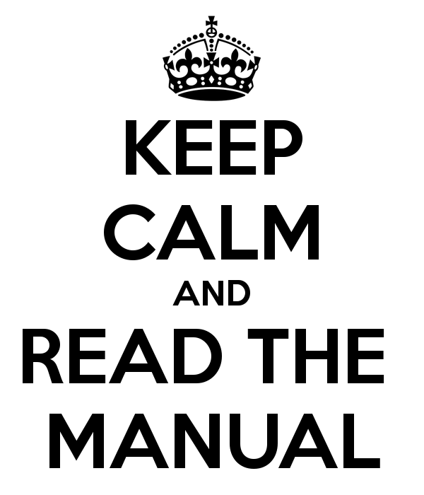
RTFM
Definition (RTFM): The acronym RTFM stands for “Read. The. F***ing. Manual.”.

Slide 42
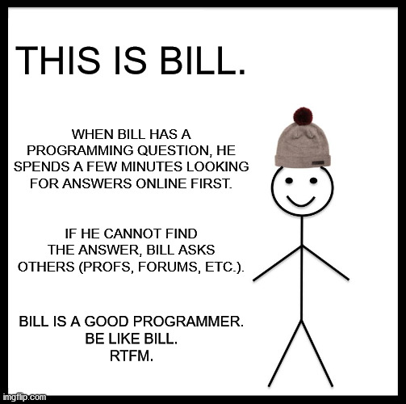
RTFM
Definition (RTFM): The acronym RTFM stands for “Read. The. F***ing. Manual.”.
While it may sound rude, RTFM is positively used in computer science communities, to encourage people to try to help themselves first, before seeking assistance from others (other being professors, classmates, StackOverflow, ChatGPT, etc.)
(https://en.wikipedia.org/wiki/RTFM)

Slide 43

Matt’s Great advice
Matt’s Great Advice: Do not fear the Python documentation.
No programmer in the world knows everything about every function, method and variable type in Python.
Instead, we know where and how to find the information online, when needed.
Make it a habit to look for the Python documentation when in doubt or looking for something specific!

Slide 44
Additional cool stuff on lists
If time allows…

Slide 45
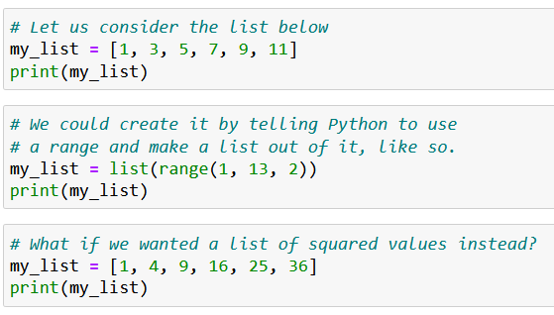
“Pythonic” loops
Definition (Pythonic loop): A Pythonic loop is a programming concept, where a list of elements is generated by integrating a for loop inside a list definition.

Slide 46
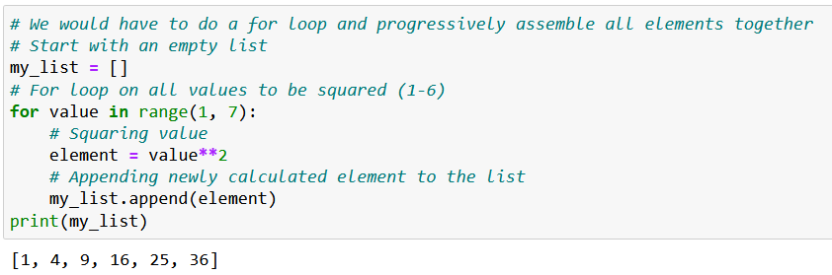
“Pythonic” loops
Definition (Pythonic loop): A Pythonic loop is a programming concept, where a list of elements is generated by integrating a for loop inside a list definition.

Slide 47
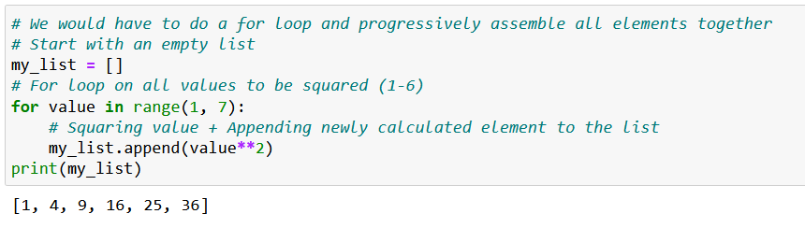
“Pythonic” loops
Definition (Pythonic loop): A Pythonic loop is a programming concept, where a list of elements is generated by integrating a for loop inside a list definition.

Slide 48
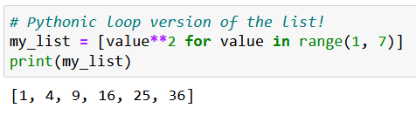
“Pythonic” loops
Definition (Pythonic loop): A Pythonic loop is a programming concept, where a list of elements is generated by integrating a for loop inside a list definition.

Slide 49
“Pythonic” loops
Definition (Pythonic loop): A Pythonic loop is a programming concept, where a list of elements is generated by integrating a for loop inside a list definition.

Slide 50
“Pythonic” loops
Definition (Pythonic loop): A Pythonic loop is a programming concept, where a list of elements is generated by integrating a for loop inside a list definition.

Slide 51
“Pythonic” loops
Definition (Pythonic loop): A Pythonic loop is a programming concept, where a list of elements is generated by integrating a for loop inside a list definition.

Slide 52
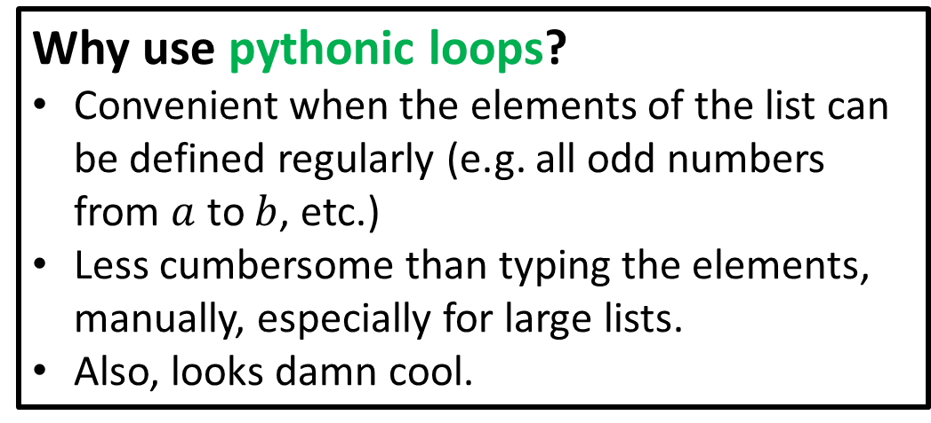
“Pythonic” loops
Definition (Pythonic loop): A Pythonic loop is a programming concept, where a list of elements is generated by integrating a for loop inside a list definition.
Why use pythonic loops?
Convenient when the elements of the list can be defined regularly (e.g. all odd numbers from $a$ to $b$, etc.)
Less cumbersome than typing the elements, manually, especially for large lists.
Also, looks damn cool.

Slide 53
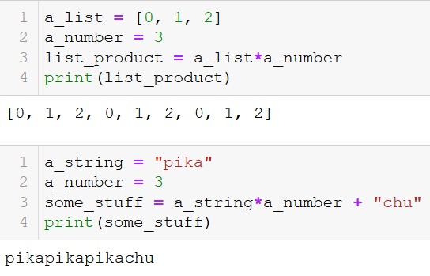
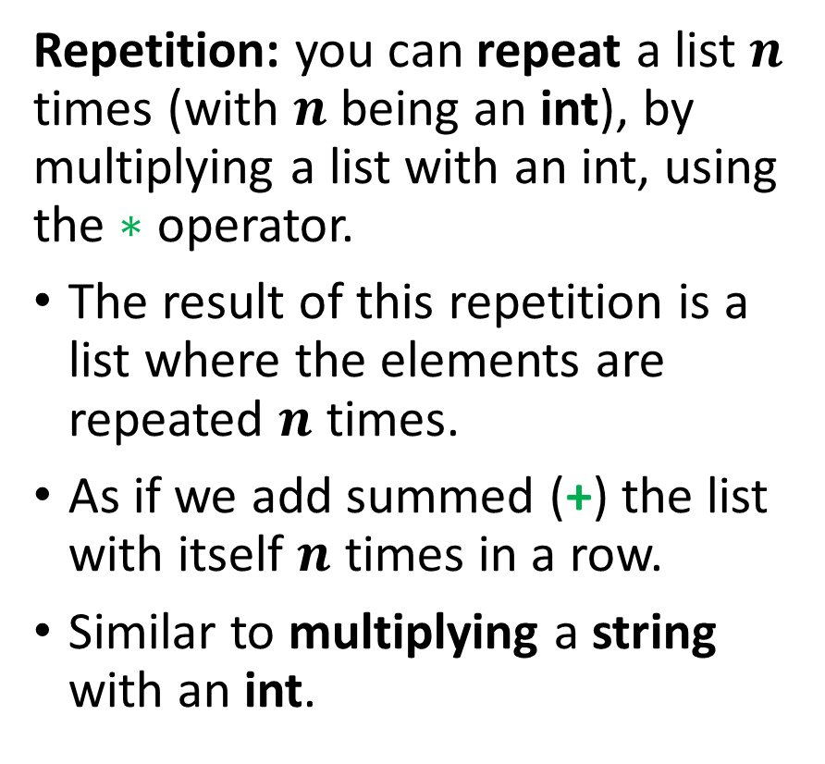

Repetition: $∗$ operator overloading
Repetition: you can repeat a list $n$ times (with $n$ being an int), by multiplying a list with an int, using the $∗$ operator.
The result of this repetition is a list where the elements are repeated $n$ times.
As if we add summed (+) the list with itself $n$ times in a row.
Similar to multiplying a string with an int.

Slide 54
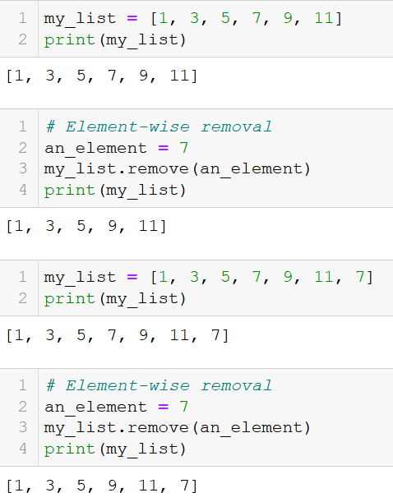
Element-wise removal
Element-wise removal: the remove() method removes the element passed as its parameter, from the list on which the method is applied.
The remove() method changes the list as a result.
Note: if the element appear multiple times, it is only removed once, when it is first encountered.

Slide 55
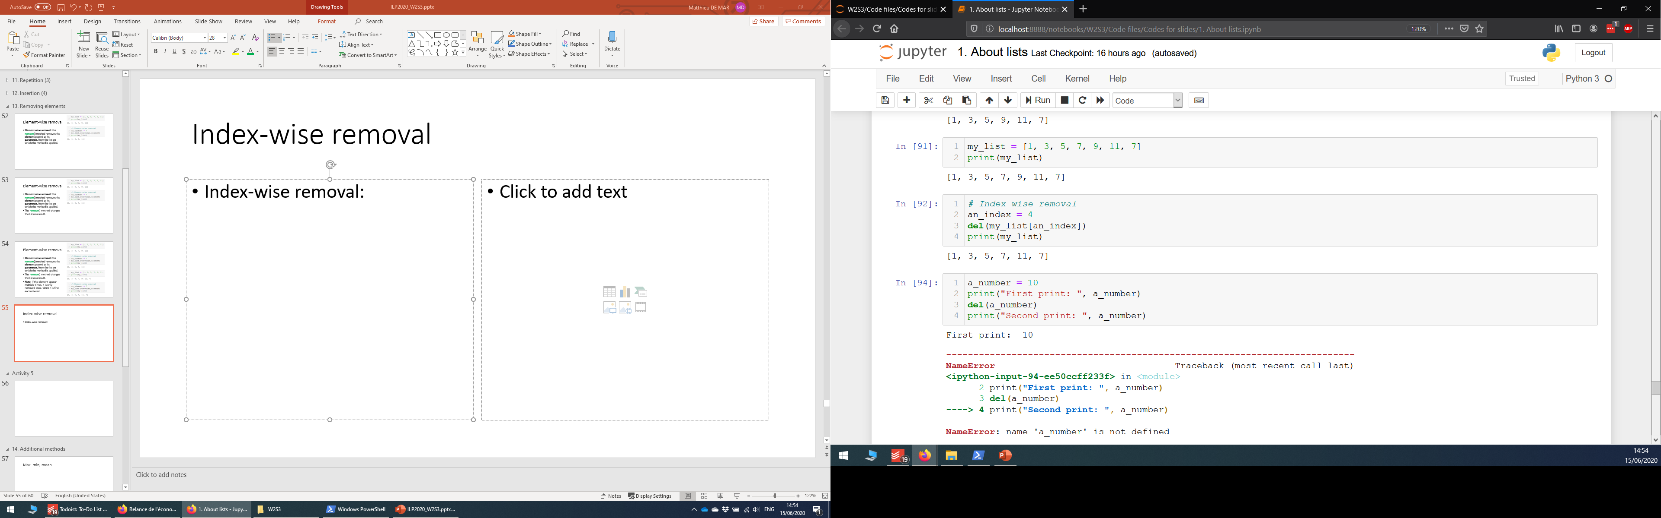
Index-wise removal
Index-wise removal: you can remove an element at a given index by using the del function on the element itself.
Note: the del function can be used on any variable, of any type, to remove it from the Python memory.

Slide 56
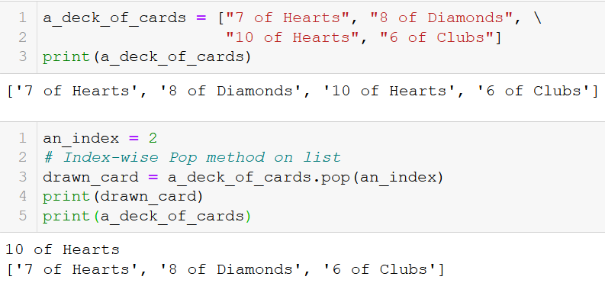
Index-wise extraction
Index-wise extraction: you can extract the element of a list, at the index given as its parameter, by using the pop() method.
As with other methods, it changes the list on which it is applied.
The output of the pop() method consists of the element, which is extracted from the list, at the given index.

Slide 57
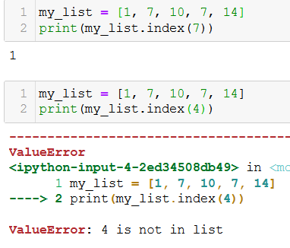
The index() method
The index() method is also useful to check for membership and find an element in a list.
It returns the index of the first occurrence of the element passed in parameter, in the list it applies to.
Careful though, as it fails if no element in the list has the value passed as parameter.

Slide 58
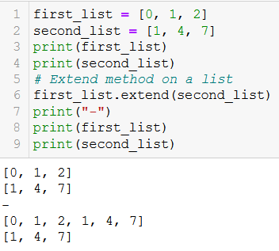
List alteration with the extend() method
Concatenation: A second list can be added to a first one with the extend() method. This method works almost like append(), as:
It changes the list on which the extend() method is applied,
And adds the elements of the second lists to the first one.
At the end of the operation, the first list will be changed. No reassignment needed.

Slide 59
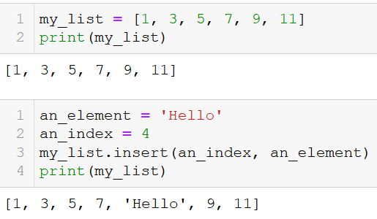
Inserting an element in a list
Insertion: You can insert an element, at a given index, by using the insert() method.
As with the extend() and append() methods, the insert() method is applied on a list.
It receives an index as its first parameter and an element as its second parameter.
And it changes the list as a result.

Slide 60
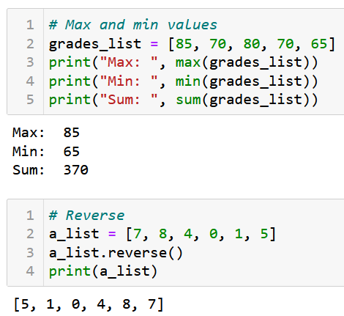
Additional methods and functions on lists
Many other additional methods and functions can be used on lists.
Maximum: the max() function returns the element with maximal value.
Minimum: the min() function returns the element with maximal value.
Sum: the sum() function returns the sum of elements in list.
Reverse: the reverse() method reverses the elements in a list.

Slide 61
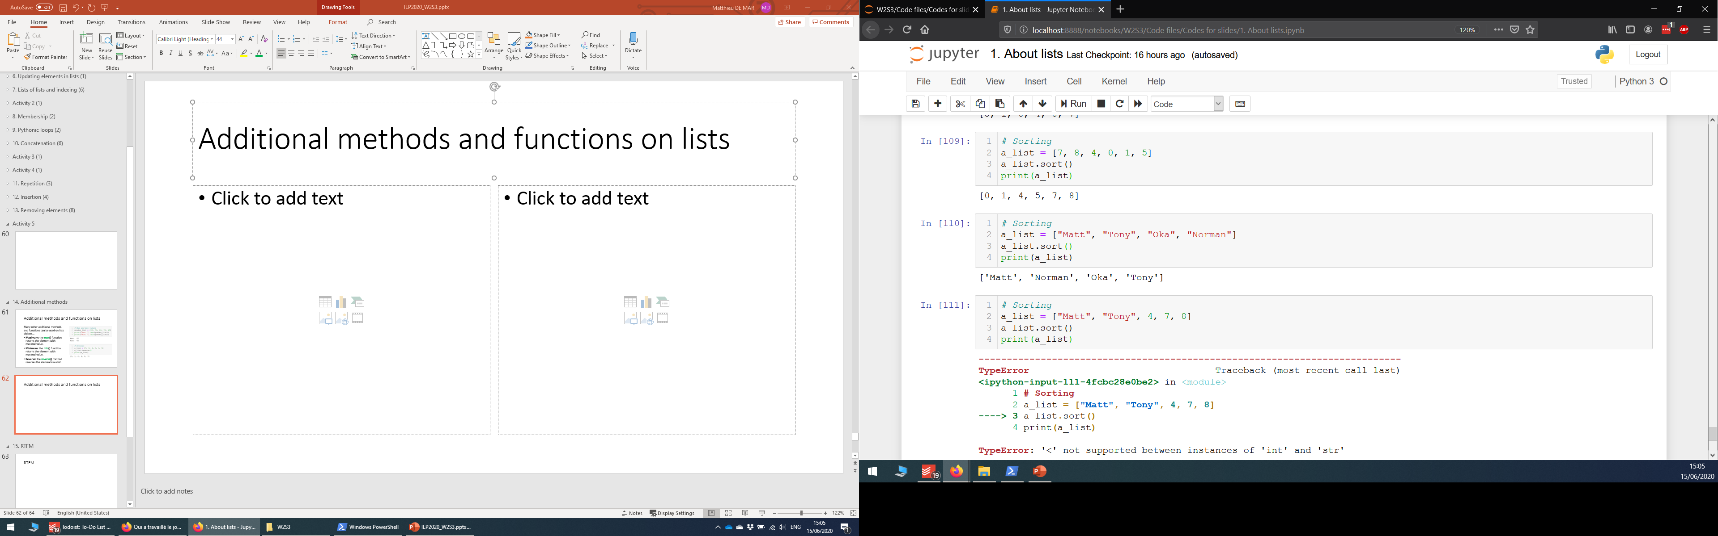
Additional methods and functions on lists
Many other additional methods and functions can be used on lists.
Sorting: the sort() method can be used to sort the elements,
In ascending order for numerical elements,
And in alphabetical order for string elements.
Note: does not work on lists with mixed types elements.

Slide 62
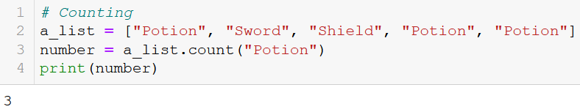
Additional methods and functions on lists
Many other additional methods and functions can be used on lists.
Counting: the count() method can be used to count how many times an element appears in a list.
And many more things!

Slide 63
Conclusion (Chapter 8)
What is the list type, in detail, this time?
What are the indexing, slicing, updating and traversing a list operations?
What are lists of lists and their uses?
How to create, add and remove elements from a list?
What are advanced operations on list such as concatenation, repetition, insertion, etc?
What does RTFM mean?
Practice on lists.

Slide 64

Please download and install the Slido app on all computers you use
What will be the output of this code?
ⓘ Start presenting to display the poll results on this slide.

Slide 65
Please download and install the Slido app on all computers you use
What will be the output of this code?
ⓘ Start presenting to display the poll results on this slide.

Slide 66
Please download and install the Slido app on all computers you use
Which of these four lists (a,b,c and d) is empty, i.e. has no elements in it?
ⓘ Start presenting to display the poll results on this slide.

Slide 67
Please download and install the Slido app on all computers you use
What will be displayed?
ⓘ Start presenting to display the poll results on this slide.

